Slide 1
Procesamiento de Vídeo Digital
Grado en Ingeniería de Tecnologías de Telecomunicación
Imágenes de alto rango dinámico
Javier Mateos Delgado
jmd@decsai.ugr.es

Slide 2
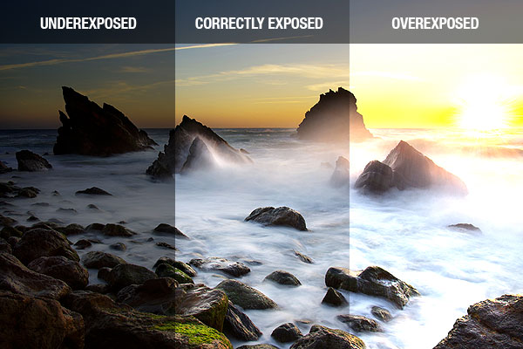
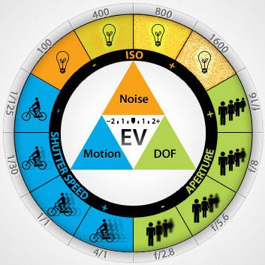
Exposición (recordatorio)
Exposición: cantidad de luz que recibe el sensor para que se forme una imagen.
Subexposición: La cantidad de luz es insuficiente para ver con perfección.
Sobrexposición: La cantidad de luz es demasiada para poder ver con perfección.
Mecanismos de control de la exposición:
Tiempo de exposición
Apertura del diafragma
Sensibilidad ISO
Lectura recomendada: Curso de fotografía digital http://www.thewebfoto.com

Slide 3
La cámara (recordatorio)
Círculo de confusión
escena
lente
sensor
[http://hyperphysics.phy-astr.gsu.edu/hbasees/geoopt/lenseq.html]

Slide 4
La cámara (recordatorio)

Slide 5
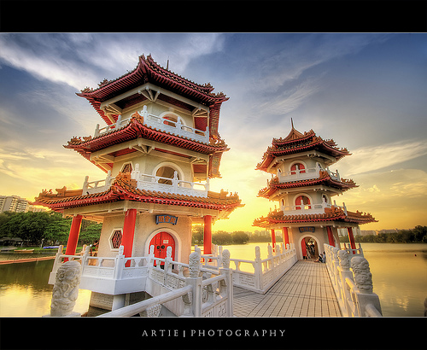
High Dynamic Range Images
Slides from Paul Debevec and Alexei A. Efros
Notes:
http://www.flickr.com/photos/artiephotography/3513060620/

Slide 6
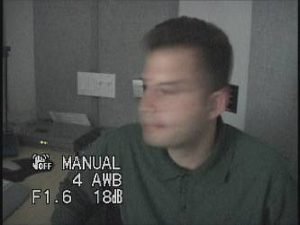
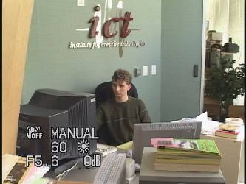
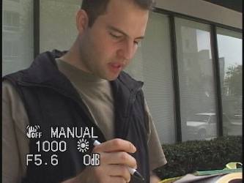
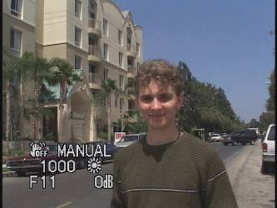
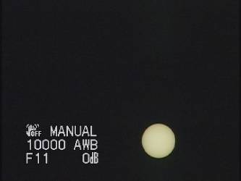
Problem: Dynamic Range
1
The real world is high dynamic range.
1500
25,000
400,000
2,000,000,000

Slide 7
Long Exposure
10⁻⁶
High dynamic range
10⁶
Real world
10⁻⁶
10⁶
Picture
^{0 to 255}

Slide 8
Short Exposure
10⁻⁶
High dynamic range
10⁶
Real world
10⁻⁶
10⁶
Picture
^{0 to 255}

Slide 9
Image
pixel (312, 284) = 42
42 photons?
Notes:
2

Slide 10
Camera Calibration
Geometric
How pixel coordinates relate to directions in the world
Radiometric
How pixel values relate to radiance amounts in the world
Notes:
Today, we are concerned with radiometric calibration.
James: Photometric vs. radiometric -> Debevec and Malik discuss this a little in paragraph 3 of Section 2.1.
http://www.pauldebevec.com/Research/HDR/debevec-siggraph97.pdf

Slide 11
Camera Calibration
Geometric
How pixel coordinates relate to directions in the world in other images.
Radiometric
How pixel values relate to radiance amounts in the world in other images.
Notes:
What we will estimate is actually a relative value of the radiance up to a scale factor.

Slide 12
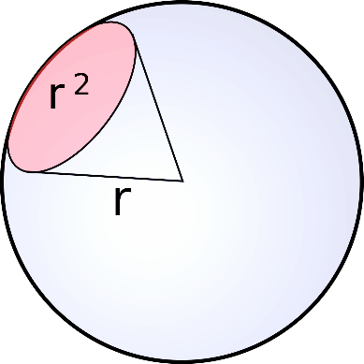
The Image Acquisition Pipeline
Lens
Radiance: Radiant flux (power) emitted, reflected, transmitted or received by a given surface per unit solid angle.
Scene
radiance
(W/sr/m )
Watts per steradian per square meter
2
Solid angle
Measured in steradians
This is a directional quantity. (Often called ‘intensity’ – confusing.)
Notes:
3
Note: Response of the lens to scene radiance is not strictly linear – glass reflects some light, some light is blocked, etc.
Solid angle: https://en.wikipedia.org/wiki/Solid_angle

Slide 13
The Image Acquisition Pipeline
Lens
Shutter
Scene
radiance
(W/sr/m )
Sensor
irradiance
(W/m )
∫
Sensor
exposure
2
2
Δt
Irradiance: Radiant flux (power) received by a surface per unit area. Not directional (collected at surface). (Often called ‘intensity’ – great, also confusing.)
Notes:
3

Slide 14
The Image Acquisition Pipeline
Lens
Shutter
Scene
radiance
(W/sr/m )
Sensor
irradiance
(W/m )
∫
Sensor
exposure
2
2
Δt
CCD
ADC
Remapping
Analog
voltages
Digital
values
Pixel
values
Raw Image
JPEG Image
Notes:
3

Slide 15
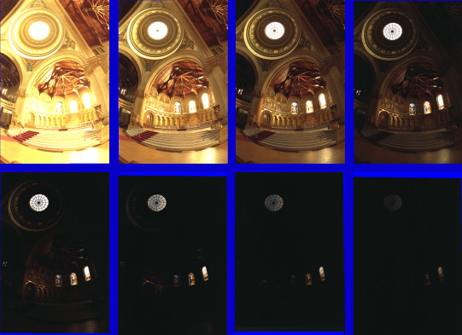
Varying Exposure
Notes:
Memorial church, Stanford.
No image is satisfying as none capture the sense of place that we would see when visiting.

Slide 16
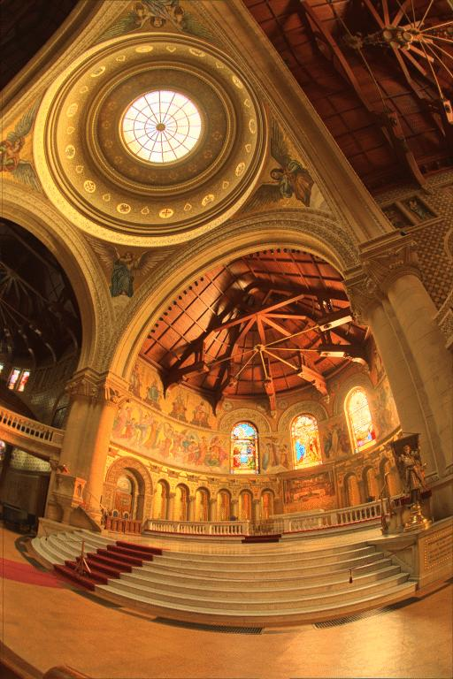
What do we see?
Vs.

Slide 17
Camera is not a photometer!
Limited dynamic range
Perhaps use multiple exposures?
Unknown, nonlinear response
Not possible to convert pixel values to radiance
Solution:
Recover response curve from multiple exposures, then reconstruct the radiance map
Notes:
4

Slide 18
Camera is not a photometer!
Key observation:
We do not know the absolute value of exposure at each pixel.
Assume scene is static.
We know that the scene radiance remains constant across an image sequence.
Notes:
4

Slide 19
Recovering High Dynamic Range Radiance Maps from Photographs
Paul Debevec
Jitendra Malik
Computer Science Division
University of California at Berkeley
August 1997
Notes:
1

Slide 20
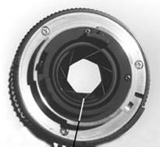
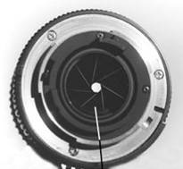
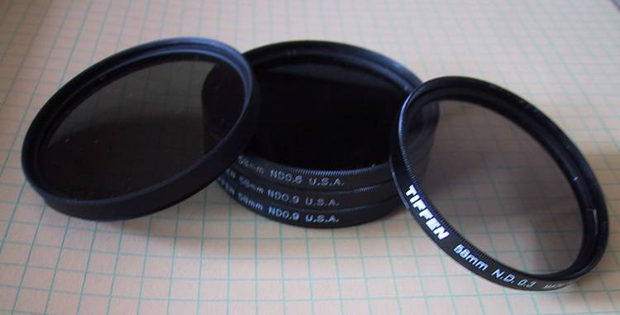
Ways to vary exposure
Shutter Speed (*)
F/stop (aperture, iris)
Neutral Density (ND) Filters

Slide 21
Shutter Speed
Ranges: Canon D30: 30 to 1/4,000 sec.
Sony VX2000: ¼ to 1/10,000 sec.
Pros:
Directly varies the exposure
Usually accurate and repeatable
Issues:
Noise in long exposures

Slide 22
Shutter Speed
Note: shutter times usually obey a power series – each “stop” is a factor of 2
¼, 1/8, 1/15, 1/30, 1/60, 1/125, 1/250, 1/500, 1/1000 sec
Usually really is:
¼, 1/8, 1/16, 1/32, 1/64, 1/128, 1/256, 1/512, 1/1024 sec

Slide 23
Why not the aperture or ND filters?
Varying aperture changes depth of field.
Image content changes.
ND filters are inconvenient and time consuming to put on.
Likely to move camera -> breaks static scene

Slide 24
Setup
1. Take set of exposures with varying shutter speed Δt
2. Scene is static, so radiance is fixed
3. Know pixel values output
4. Assume camera response curve is non-linear but monotonic
Notes:
10
g() is the unknown discrete inverse response function.
Z_{ij} is the known (but noisy) pixel value from 0 to 255 for location i in image j.
E_{i} is the unknown radiance at location i.
Δt_{j} is the known exposure time, e.g. 1/16, 1/125, etc. for image j

Slide 25
The Algorithm
Image series
• 1
• 1
• 1
• 1
• 1
• 2
• 2
• 2
• 2
• 2
• 3
• 3
• 3
• 3
• 3
Δt = 1/64 sec
Δt = 1/16 sec
Δt = 1/4 sec
Δt = 1 sec
Δt = 4 sec
Pixel Value Z = f (Exposure)
Exposure = Radiance × Δt
log Exposure = log Radiance + log Δt
Notes:
10
g() is the unknown discrete inverse response function.
Z_{ij} is the known (but noisy) pixel value from 0 to 255 for location i in image j.
E_{i} is the unknown radiance at location i.
Δt_{j} is the known exposure time, e.g. 1/16, 1/125, etc. for image j

Slide 26
Imaging system response function f
255
Pixel
value
f monotonically increasing -> invertible
0
log Exposure = log (Radiance × Δt)
(CCD photon count)
Notes:
1
is this curve sloped the wrong way? Isn’t more detail given to darker regions? No it’s correct because the x axis is log scale.

Slide 27
The Algorithm
Assuming unit radiance
for each pixel
Image series
• 1
• 1
• 1
• 1
• 1
• 2
• 2
• 2
• 2
• 2
3
• 3
• 3
• 3
• 3
• 3
2
Pixel value
Δt = 1/64 sec
Δt = 1/16 sec
Δt = 1/4 sec
Δt = 1 sec
Δt = 4 sec
1
ln Exposure
Notes:
10

Slide 28
Response Curve
Assuming unit radiance
for each pixel
After adjusting radiances to obtain a smooth response curve
3
2
Pixel value
Pixel value
1
ln Exposure
ln Exposure

Slide 29
The Algorithm
Image series
Assuming unit radiance
for each pixel
• 1
• 1
• 1
• 1
• 1
• 2
• 2
• 2
• 2
• 2
• 3
• 3
• 3
• 3
• 3
3
Δt = 1/64 sec
Δt = 1/16 sec
Δt = 1/4 sec
Δt = 1 sec
Δt = 4 sec
2
Pixel value
Pixel Value Z = f(Exposure)
1
Exposure = Radiance x Δt
f ⁻¹(Pixel Value Z) = Radiance x Δt
ln Exposure
ln Exposure = ln Radiance + ln Δt
ln f ⁻¹(Pixel Value Z) = ln(Radiance) + ln(Δt)
Notes:
10

Slide 30

The Math
Let g(z) be the discrete inverse response function
For each pixel site i in each image j, want:
Solve the overdetermined linear system:
g = ln f ⁻¹
g(Pixel Value $Z_{ij}$) = ln($Radiance_{i}$) + ln(Δ$t_{j}$)
N = # pixels P = # images
fitting term

Slide 31

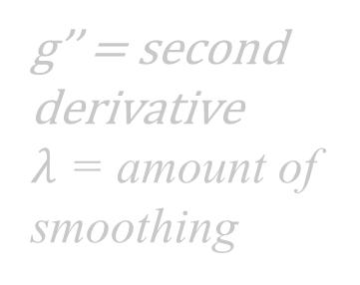
The Math
Let g(z) be the discrete inverse response function
For each pixel site i in each image j, want:
Solve the overdetermined linear system:
g = ln f ⁻¹
g(Pixel Value $Z_{ij}$) = ln($Radiance_{i}$) + ln(Δ$t_{j}$)
$Z_{ij}$ is noisy! Add smoothing
N = # pixels P = # images
g’’ = second derivative
$λ$ = amount of smoothing
fitting term
smoothness term

Slide 32
Matlab Code
function [g,lE]=gsolve(Z,B,l,w)
n = 256;
A = zeros(size(Z,1)*size(Z,2)+n+1,n+size(Z,1));
b = zeros(size(A,1),1);
k = 1; %% Include the data-fitting equations
for i=1:size(Z,1)
for j=1:size(Z,2)
wij = w(Z(i,j)+1);
A(k,Z(i,j)+1) = wij; A(k,n+i) = -wij; b(k,1) = wij * B(i,j);
k=k+1;
end
end
A(k,129) = 1; %% Fix the curve by setting its middle value to 0
k=k+1;
for i=1:n-2 %% Include the smoothness equations
A(k,i)=l*w(i+1); A(k,i+1)=-2*l*w(i+1); A(k,i+2)=l*w(i+1);
k=k+1;
end
x = A\b; %% Solve the system using SVD
g = x(1:n);
lE = x(n+1:size(x,1));

Slide 33
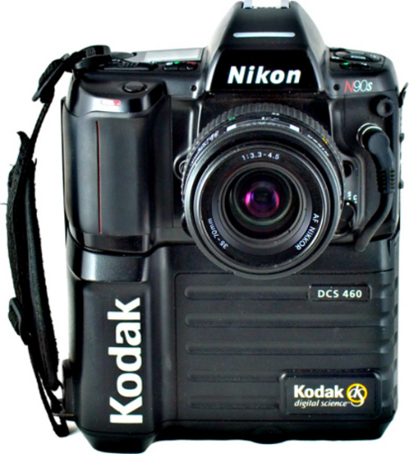
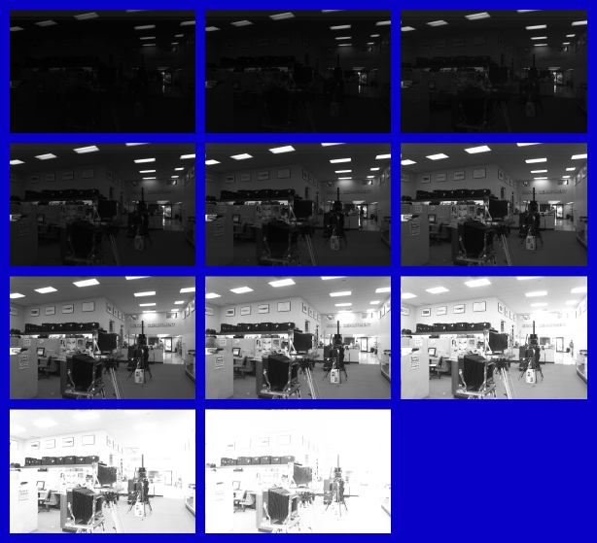
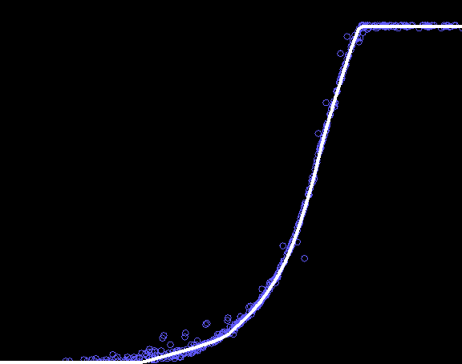
Results: Monochromatic Digital Camera
Kodak DCS460 1/30 to 30 sec
Recovered response curve
Pixel value
log Exposure
Notes:
13
Kodak DCS460 is a ‘digital camera back’ – a sensor and processor attached to an existing camera and lens system.
6MP sensor.
Kodak DCS460 also came in a color variant - Kodak DCS460c.
More info: https://www.digitalkameramuseum.de/en/cameras/item/kodak-dcs-460
Camera image: https://productz.com/en/kodak-dcs460/p/9BM2

Slide 34
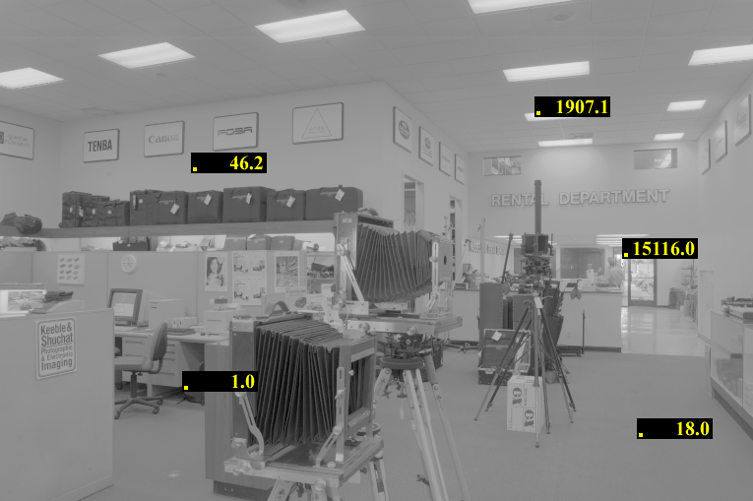
Reconstructed radiance map

Slide 35
Results: Color Film
Kodak Gold ASA 100, PhotoCD
Notes:
14

Slide 36
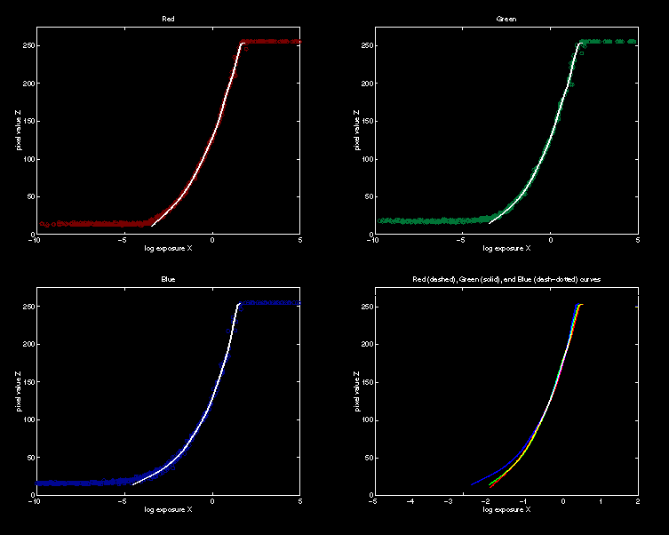

Recovered Response Curves
Red
Green
Note: we recover $g$ for each of RGB
Blue
RGB
Notes:
15

Slide 37
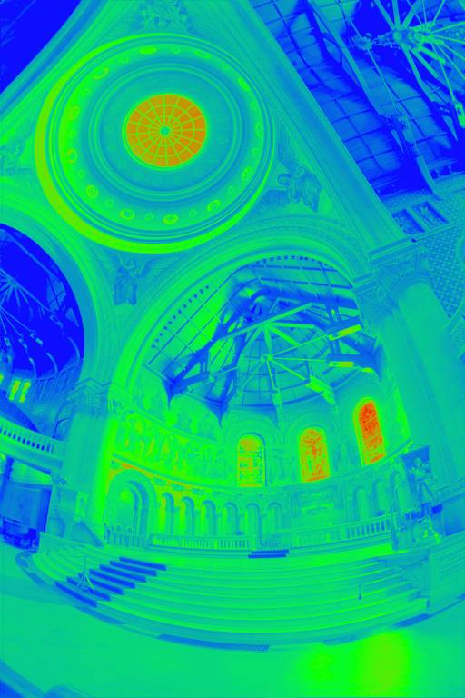
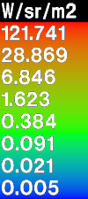
The Radiance Map
$E$ = Radiance map (averaged across RGB)
False color map to show relative range of output
Notes:
17
James note: this may not strictly be an average (a mean), and some weighting of the different channels may have occurred.

Slide 38
How do we store this?

Slide 39
Portable FloatMap (.pfm)
12 bytes per pixel, 4 for each channel
sign
exponent
mantissa
Text header similar to Jeff Poskanzer’s .ppm image format:
PF
768 512
1
<binary image data>
Floating Point TIFF similar

Slide 40
Radiance Format (.pic, .hdr)
32 bits / pixel
Red Green Blue Exponent
(145, 215, 87, 149) =
(145, 215, 87) * 2^(149-128) =
(1190000, 1760000, 713000)
(145, 215, 87, 103) =
(145, 215, 87) * 2^(103-128) =
(0.00000432, 0.00000641, 0.00000259)
Ward, Greg. "Real Pixels," in Graphics Gems IV, edited by James Arvo, Academic Press, 1994

Slide 41
ILM’s OpenEXR (.exr)
6 bytes per pixel, 2 for each channel, compressed
5 bit exponent
10 bit mantissa
sign
exponent
mantissa
Several lossless compression options, 2:1 typical
Compatible with the “half” datatype in NVidia's Cg
Supported natively on GeForce FX and Quadro FX
Available at http://www.openexr.net/

Slide 42
Now What?
$E$ = Radiance map (averaged across RGB)
Notes:
17

Slide 43
Tone Mapping
How can we do this?
Linear scaling?, thresholding? Suggestions?
10⁻⁶
High dynamic range
10⁶
Real World
Ray Traced
World (Radiance)
10⁻⁶
10⁶
Display/
Printer
^{0 to 255}

Slide 44
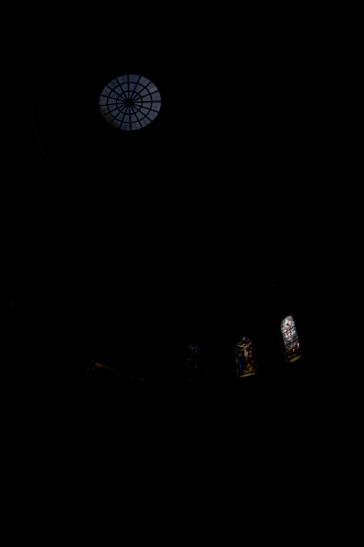
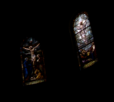
The Radiance Map
Linearly scaled to
display device
Notes:
16

Slide 45
Simple Global Operator
Compression curve needs to
Bring everything within range
Leave dark areas alone
In other words
Asymptote at 255
Derivative of 1 at 0

Slide 46
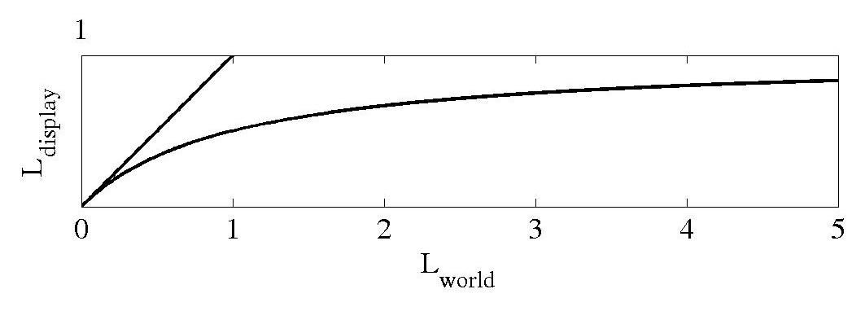


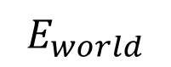
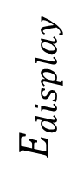

Global Operator (Reinhard et al.)
$$E_{display}=\frac{E_{world}}{1+E_{world}}$$
$E$ = Radiance map
$$E_{display}=E_{world}$$
$$E_{display}$$
$$E_{world}$$
Notes:
Reinhard et al., Photographic tone reproduction for digital images
SIGGRAPH 2002
https://doi.org/10.1145/566570.566575
Note that Reinhard et al. use luminance instead of radiance, and use $L$ in their notation for a luminance map (not $E$ and a radiance map). For our purposes, we will treat them as the same.

Slide 47
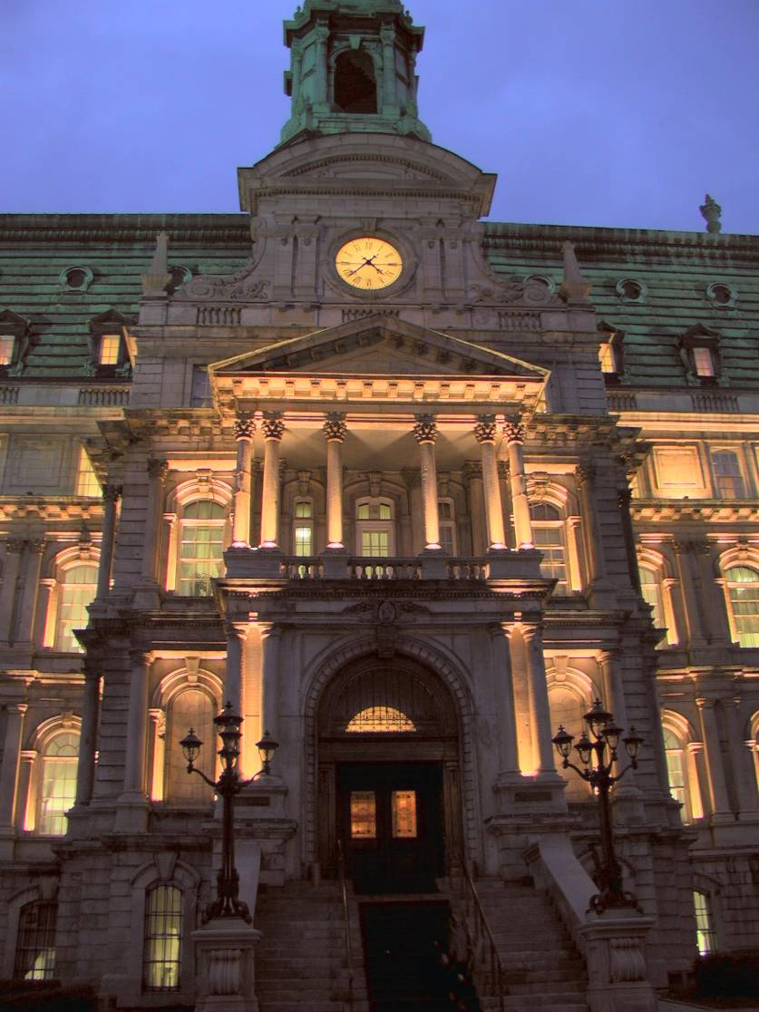
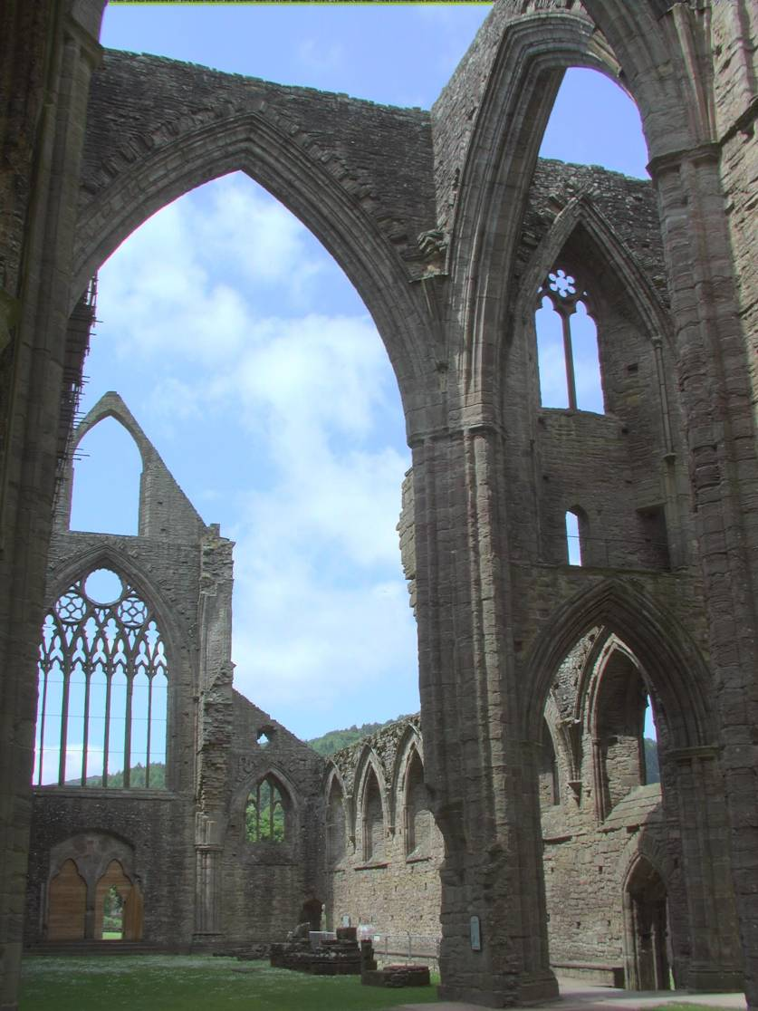
Global Operator Results

Slide 48
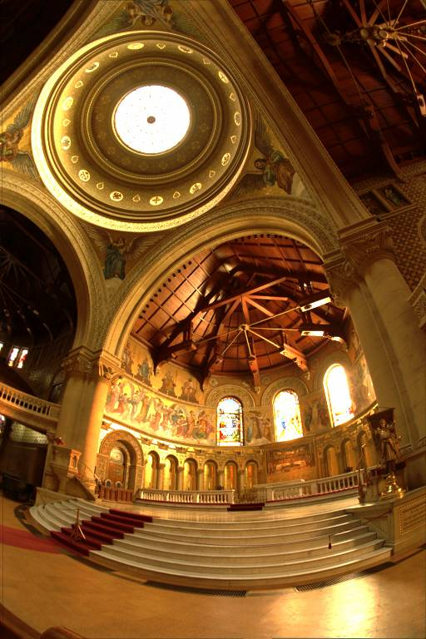
Reinhart Operator
Darkest 0.1% scaled
to display device

Slide 49
What do we see?
Vs.

Slide 50
Issues with multi-exposure HDR
Scene and camera need to be static
Camera sensors are getting better and better
Display devices are fairly limited anyway (although getting better).

Slide 51
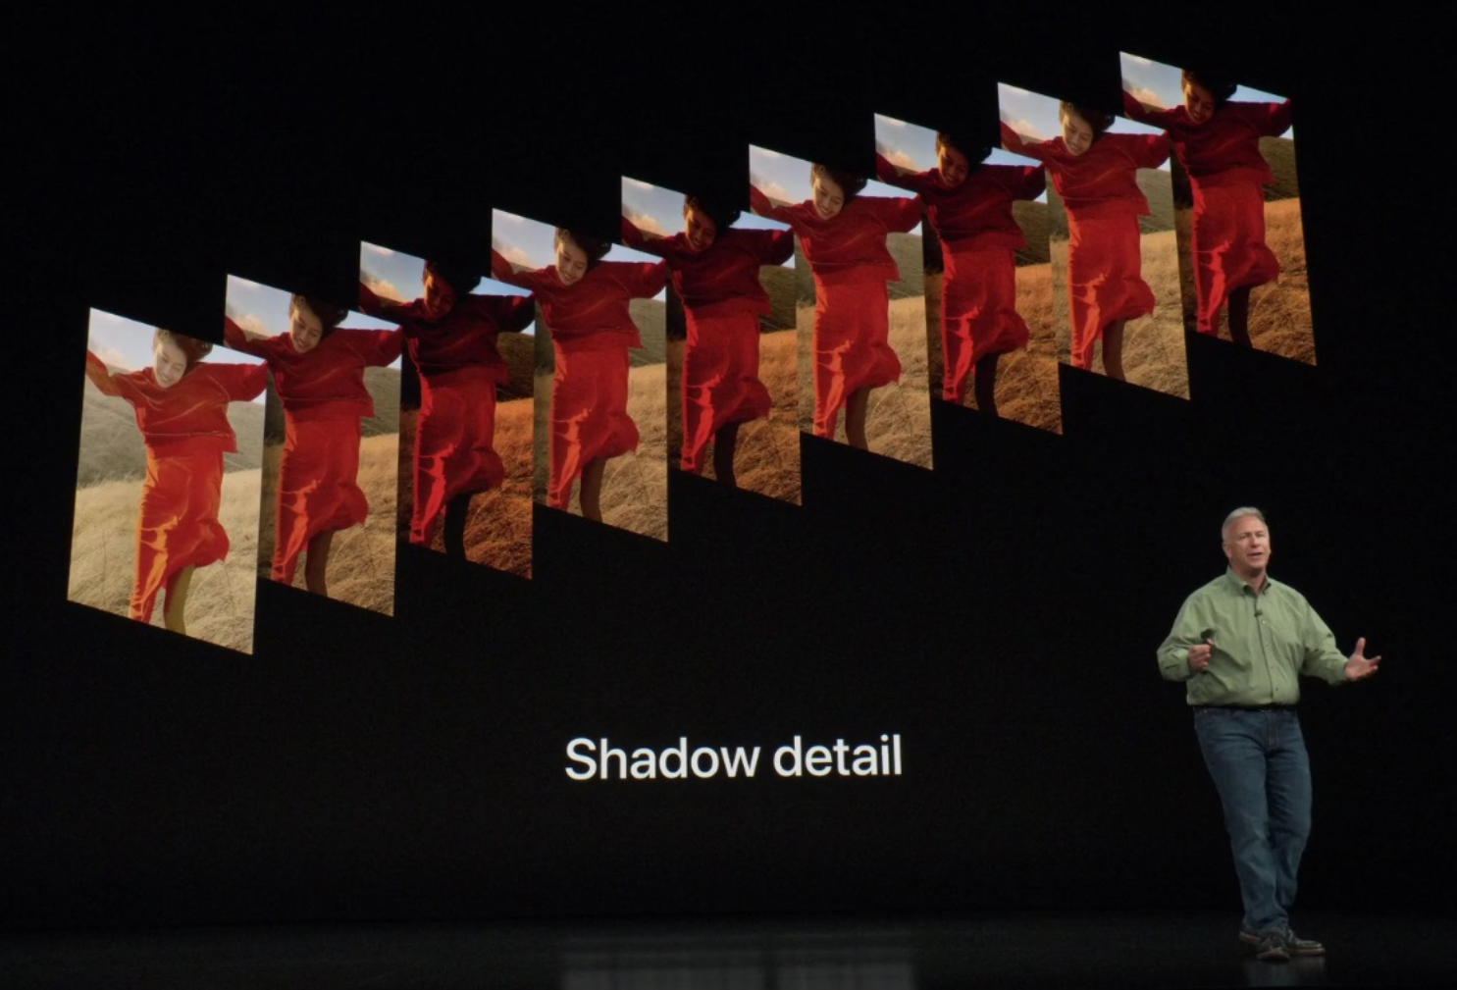
High-dynamic range on smartphones
Apple, iPhone X/XS/XR
“We have a brand new feature we call smart HDR”
Always-on bracketed exposures:
Even when you aren’t taking pictures, the camera saves to a buffer with varying exposures.
Use that data to do HDR
[https://techcrunch.com/2018/09/12/the-7-most-egregious-fibs-apple-told-about-the-iphone-xs-camera-today/]

Slide 52
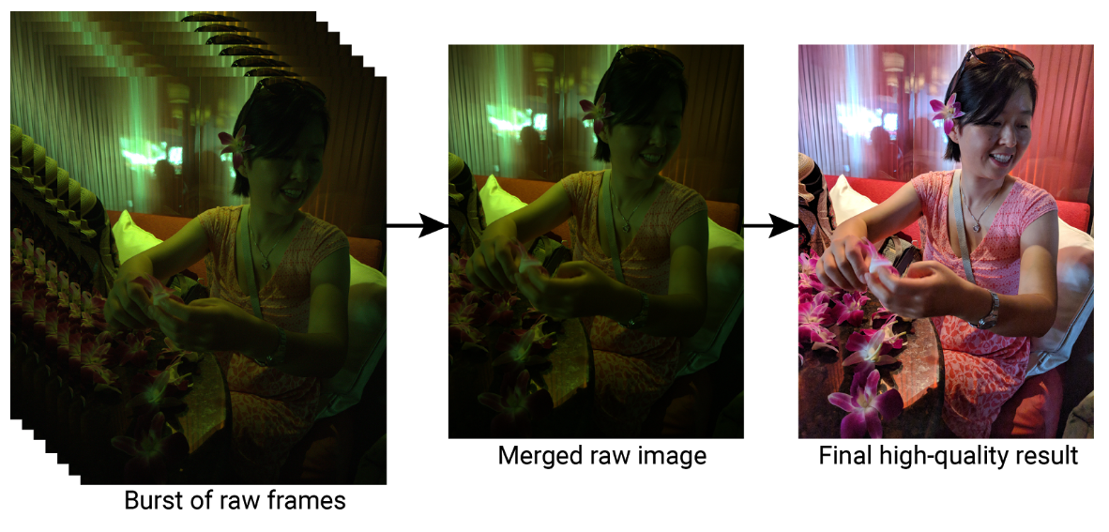
Google Pixel phones (2016)
Notes:
https://ai.googleblog.com/2018/02/introducing-hdr-burst-photography.html

Slide 53
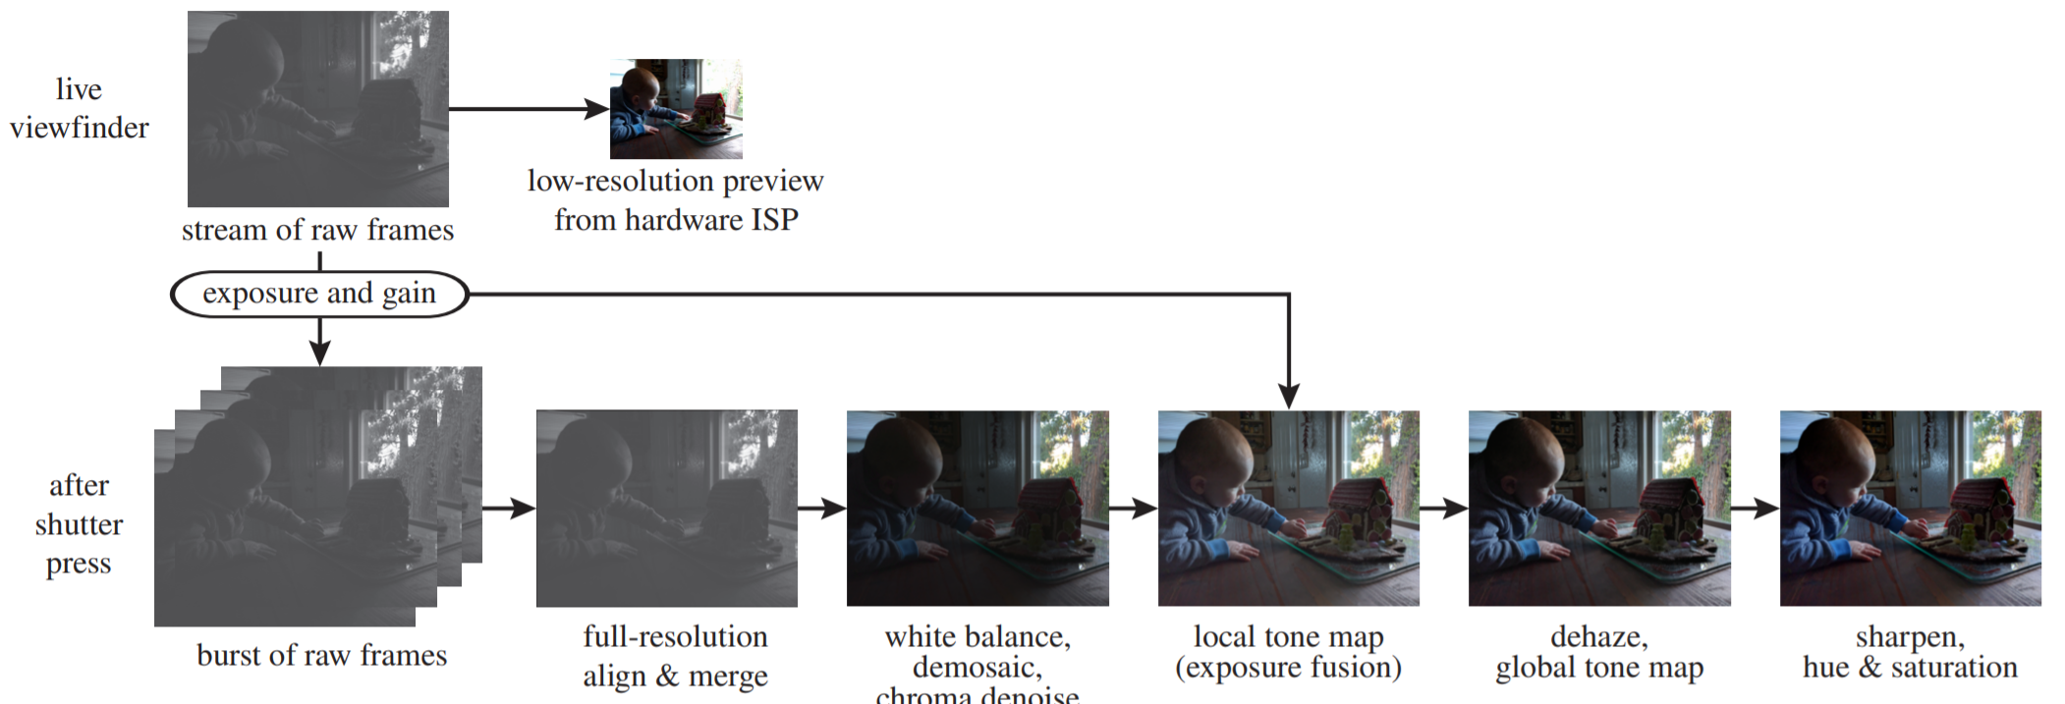
Notes:
Samuel W. Hasinoff, Dillon Sharlet, Ryan Geiss, Andrew Adams, Jonathan T. Barron, Florian Kainz, Jiawen Chen, and Marc Levoy. 2016. Burst photography for high dynamic range and low-light imaging on mobile cameras. ACM Trans. Graph. 35, 6, Article 192 (November 2016), 12 pages. DOI: https://doi.org/10.1145/2980179.2980254

Slide 54
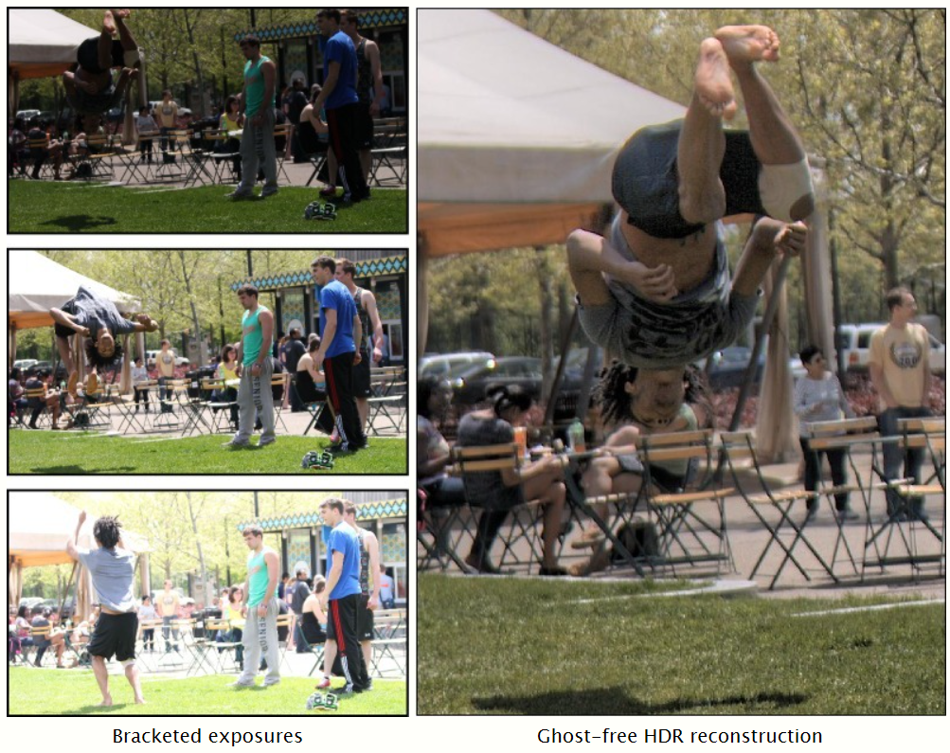
Ghosting
Notes:
Automatic Noise Modeling for Ghost-free HDR Reconstruction
Miguel Granados, Kwang In Kim, James Tompkin, Christian Theobalt
ACM Transactions on Graphics (SIGGRAPH Asia 2013)
Project webpage

Slide 55
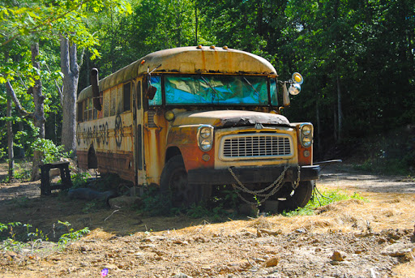
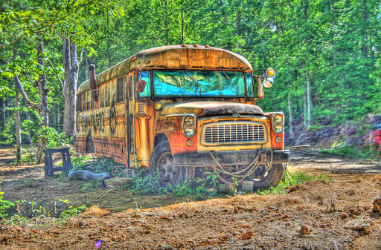
Tone-mapped HDR as a look
[http://pancake-ninja.blogspot.com/2011/06/hdr-bus.html]

Slide 56
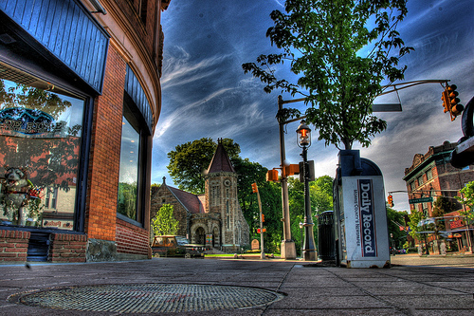
Local tone mapping / bilateral filter
Flickr user mapgoblin
Notes:
http://www.flickr.com/photos/mapgoblin/142350388/

Slide 57
Recovering HDR radiance maps for the project
Additional slides not shown in class
[James Hays]

Slide 58
Debevec and Malik 1997
Image series
• 1
• 1
• 1
• 1
• 1
• 2
• 2
• 2
• 2
• 2
• 3
• 3
• 3
• 3
• 3
Δt = 1/64 sec
Δt = 1/16 sec
Δt = 1/4 sec
Δt = 1 sec
Δt = 4 sec
Pixel Value Z = f(Exposure)
Pixel Value Z = f(Radiance x Δt)
f ⁻¹(Pixel Value Z) = Radiance x Δt
g(Pixel Value Z) = ln(Radiance) + ln(Δt)
Notes:
10
Assumption – f is monotonic and invertible. Probably true.

Slide 59
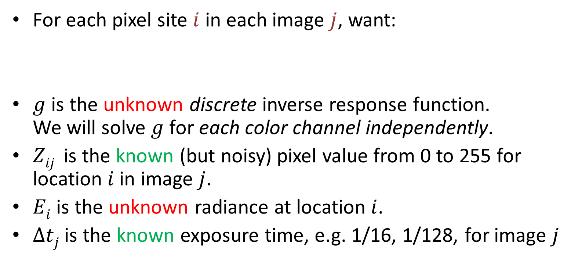
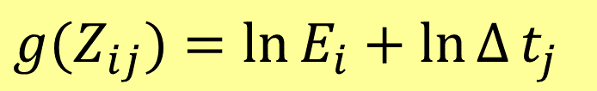
Image Sequence
• 1
• 1
• 1
• 2
• 2
• 2
• 3
• 3
• 3
Δt_{j} = 1/64 sec
Δt_{j} = 1/16 sec
Δt_{j} = 1/4 sec
For each pixel site $i$ in each image $j$, want:
$g$ is the unknown discrete inverse response function. We will solve $g$ for each color channel independently.
$Zij$ is the known (but noisy) pixel value from 0 to 255 for location $i$ in image $j$.
$Ei$ is the unknown radiance at location $i$.
$Δtj$ is the known exposure time, e.g. 1/16, 1/128, for image $j$
$$g(Z_{ij})=\ln{E_{i}}+\ln{Δ}t_{j}$$
Equation 2 in Debevec
Notes:
10

Slide 60
Image Sequence
• 1
• 1
• 1
• 2
• 2
• 2
• 3
• 3
• 3
Δt_{j} = 1/64 sec
Δt_{j} = 1/16 sec
Δt_{j} = 1/4 sec
-4.9875
-4.7250
-4.4628
-4.2095
-3.9744
…
2.0197
2.0654
2.1149
2.1686
2.2255
Example of what g(Z_{ij}) looks like
256 unknowns
Notes:
10

Slide 61
Image Sequence
• 1
• 1
• 1
• 2
• 2
• 2
• 3
• 3
• 3
Δt_{j} = 1/64 sec
Δt_{j} = 1/16 sec
Δt_{j} = 1/4 sec
-4.9875
-4.7250
-4.4628
-4.2095
-3.9744
…
2.0197
2.0654
2.1149
2.1686
2.2255
Example of what g(Z_{ij}) looks like
256 unknowns
Notes:
10

Slide 62
Image Sequence
• 1
• 1
• 1
• 2
• 2
• 2
• 3
• 3
• 3
Δt_{j} = 1/64 sec
Δt_{j} = 1/16 sec
Δt_{j} = 1/4 sec
-4.9875
-4.7250
-4.4628
-4.2095
-3.9744
…
2.0197
2.0654
2.1149
2.1686
2.2255
Example of what g(Z_{ij}) looks like
256 unknowns
We expect g() to vary smoothly
Notes:
10

Slide 63
Image Sequence
• 1
• 1
• 1
• 2
• 2
• 2
• 3
• 3
• 3
Δt_{j} = 1/64 sec
Δt_{j} = 1/16 sec
Δt_{j} = 1/4 sec
-4.9875
-4.7250
-4.4628
-4.2095
-3.9744
…
2.0197
2.0654
2.1149
2.1686
2.2255
Example of what g(Z_{ij}) looks like
256 unknowns
Add constraints on second derivative of g()
We expect g() to vary smoothly
Notes:
10

Slide 64
Image Sequence
• 1
• 1
• 1
• 2
• 2
• 2
• 3
• 3
• 3
Δt_{j} = 1/64 sec
Δt_{j} = 1/16 sec
Δt_{j} = 1/4 sec
num_samples * num_images equations
-4.9875
-4.7250
-4.4628
-4.2095
-3.9744
…
2.0197
2.0654
2.1149
2.1686
2.2255
Example form of g(Z_{ij})
256 unknowns
254 equations
…
We expect g() to vary smoothly
Lock down one point in g()
Notes:
10

Slide 65
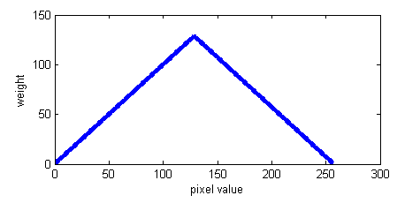
Image Sequence
We can’t trust all of these values
• 1
• 1
• 1
• 2
• 2
• 2
• 3
• 3
• 3
Δt_{j} = 1/64 sec
Δt_{j} = 1/16 sec
Δt_{j} = 1/4 sec
num_samples * num_images equations
Weight each equation by trustworthiness
254 equations
…
Lock down one point in g()
Notes:
10

Slide 66
Image Sequence
We can’t trust all of these values
• 1
• 1
• 1
• 2
• 2
• 2
• 3
• 3
• 3
Δt_{j} = 1/64 sec
Δt_{j} = 1/16 sec
Δt_{j} = 1/4 sec
Weight each equation by trustworthiness
…
Notes:
10

Slide 67
How do we convert this to Ax=b form?
A x = b
256
num_samples * num_images equations
num_samples * num_images
non-zero entries
num_samples
1
…
254
254 equations
1
256 + num_samples
1
x = A\b
MATLAB
1 equation
numpy.linalg.lstsq(A,b)
Python
Notes:
10
https://numpy.org/doc/stable/reference/generated/numpy.linalg.lstsq.html

Slide 68
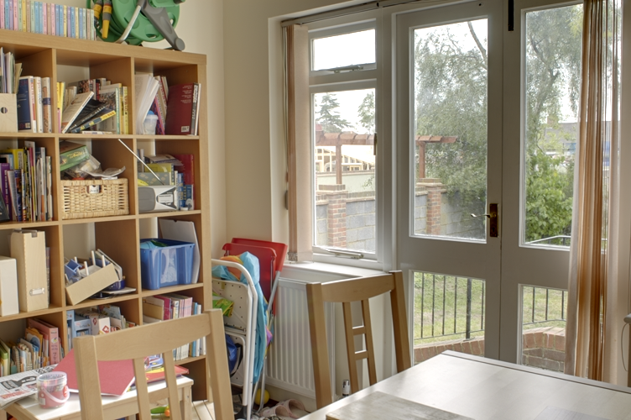
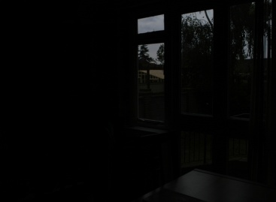
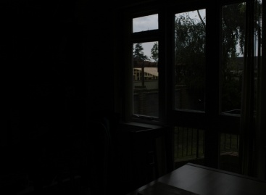
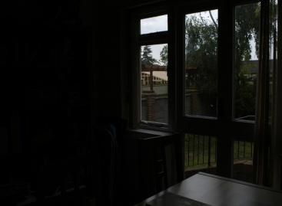
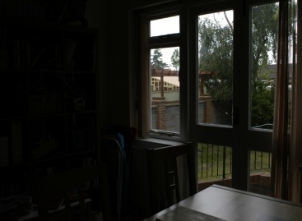
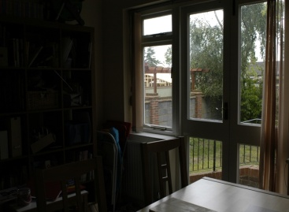
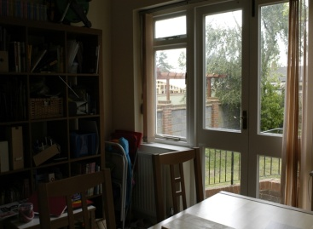
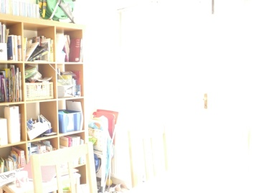
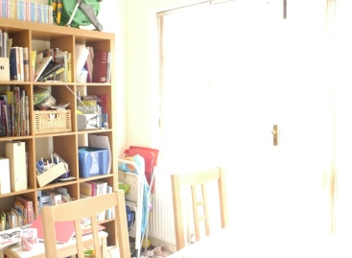
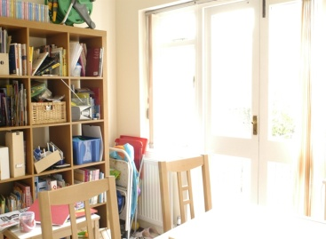



Exposure Fusion
Tom Mertens¹ Jan Kautz² Frank Van Reeth¹
¹ EDM - Hasselt University
²University College London, UK
https://dl.acm.org/citation.cfm?id=1338586 / https://mericam.github.io/
Notes:
Hi, welcome everybody.
My name is Tom Mertens, and I am gonna talk about Exposure Fusion, which is a research project I carried out together with Jan Kautz from UCL and Frank Van Reeth from Hasselt University.

Slide 69



!
!
!
!
underexposed
overexposed
both
Notes:
Exposure fusion deals with the following problem.
So, photographers are often troubled by this here: a picture is under or overexposed.
This usually happens because the dynamic range of intensities found in the scene is too high to be captured by the camera.
This problem can be avoided by manipulating the exposure settings, like shutter speed and aperture, but this is sometimes impossible, and you’ll get both under and overexposed parts.

Slide 70




High Dynamic Range photography
Multi-exposure sequence
Notes:
Now, you can simply take differently exposed images from the same vantage point, in order to create a good image that does not have these exposure artifacts, and this lies at the basis of high dynamic range photography.
Our technique deals with the same kind of input, but we take a different approach.

Slide 71
HDR Photography
HDR assembly: LDRs → HDR
[Mann and Picard, IS&T ‘95]
[Debevec and Malik, SIGGRAPH ‘97]
Tone mapping: HDR → LDR
[Durand and Dorsey, SIGGRAPH ‘02]
[Reinhard et al., SIGGRAPH ‘02]
[Fattal et al., SIGGRAPH ‘02]
[Li et al., SIGGRAPH ‘05]
[Lischinski et al., SIGGRAPH ‘06]
Exposure Fusion: LDRs → LDR
Notes:
We’ve seen a fair amount of work in the past decade on this topic
First, people have come up with ways to take multiple LDR exposures, and assembled them into a HDR image.
But this is not enough. Not only the camera, but also display devices like most monitors, do not have the capability of dealing with HDR content.
So this is why we apply tone mapping first, which is a process that maps HDR image back to LDR, in a perceptually motivated fashion. This basically means that the resulting LDR image is perceived by a human as if it still were a HDR image, it still has to look good and artifact free.
Exposure fusion basically does the same thing, but it skips the part where we compute a HDR image.
So why do this?

Slide 72







Multi-exposure
Assembly
Tone
mapping
display
Response curve
calibration
bilateral
gradient
…
High Dynamic Range photography
Notes:
Well, let’s look at the HDR photography pipeline. It’s not a simple process.
First of all, your camera’s response curve has to be calibrated. This is not so bad, but it puts an extra burden on the user, especially if she or he does not know much about HDR photography.
After the images have been assembled into an HDR image, you need to pick on of the many tone mapping operators, and then possibly tweak it in order to have the desired result. This can also be a very tedious process for a novice user.
Exposure fusion is much simpler. Not only is easier to understand, but it has less parameters to tweak, easy to implement, and it also quite efficient in terms of computation.

Slide 73




Multi-exposure
Assembly
Tone
mapping
display
Response curve
calibration
bilateral
gradient
…
High Dynamic Range photography
Multi-exposure
Exposure fusion
display

Slide 74
Idea: fuse multi-exposure sequence
Notes:
So here’s the basic idea behind our approach.
Notice how in this multi-exposure sequence you can always find “good parts”, meaning pixels that are already well-exposed.
The idea now is to detect those regions, and fuse them into a single, good-looking image.
And here a result of our approach.

Slide 75







Image Fusion
Applications
Extended depth-of-field
[Ogden et al. ‘85]
[Agarwala et al., SIGGRAPH ‘04]
Multi-sensor photography
[Burt et al. ‘93]
Non-photorealistic video
[Raskar et al., NPAR ‘04]
Exposure Fusion
Manual (Photoshop)
Image pyramid [Burt et al. ‘93]
Extended DOF
Multisensor: IR + visible
Notes:
So we want to fuse images, and this quite related to the more general concept of image fusion – people have looked at this before for other applications.
For instance, in a situation where you’re stuck with a shallow DOF, like in macrophotography, you can focus on different parts of your subject and then fuse those image into a image with extended depth-of-field.
You can also fuse image that were shot with different sensors. For instance you can combine a regular photograph with an infrared photo.
The basic idea of exposure fusion is actually not new, because people have done something similar before. In fact, you can use photoshop by manually blending between the different exposures. Of course this is quite tedious and labour-intensive
Burt et al. have suggested fusing multiple exposures, but they did this in a more general framework for image fusion. In our work however, we have specifically designed a fusion technique, specifically for this particular case.
But let’s take a closer look at this approach…

Slide 76


Pyramid Fusion
[Ogden et al. ’85, Burt et al. ‘93]
Notes:
Here are 2 images you want to fuse.

Slide 77















Pyramid Fusion
“multi-scale edge filter”
abs
max
-1 0 1
reconstruct
Pyramid decomposition
[Ogden et al. ’85, Burt et al. ‘93]
Notes:
The idea is that the fusion takes place in a pyramid decomposition, so I’m gonna refer to this method as “pyramid fusion”.
For now, it doesn’t really matter what pyramid to use: it could be a Laplacian or steerable pyramid. But intuitively, this decomposition basically acts like a edge filter, and it does so at multiple scales.
Not only can you build a pyramid, but you can convert back to your image, after you changed its content.
Here, we fuse the image by computing a pyramid by selecting for each pixel the pixel that has the maximum absolute value. So what basically happens is that you consolidate all your details (or edges) into a single image.
We then reconstruct the image, and we’re done.

Slide 78






Pyramid Fusion
Exposure fusion
Notes:
Here’s a result of this approach.
You can see that it produces an okay result, but unfortunately the colors are not the same anymore, and some parts still remain dark.
Our technique does not suffer from this problem, as it only selects and blend the best parts of the image, and does not change anything else. Whereas, pyramid fusion may significantly alter the image by only trying to maximize the amount of details.

Slide 79









X
+
Challenges:
Good weights
Good blending
Multi-exposure
Weight
Notes:
Now let’s look at our approach.
Here’s your multi-exposure sequence. For each pixel you’re gonna compute a weight map, which will indicate which pixels we want to keep.
Then, we blend this selection into the final result.
So there are 2 things we need to do, first, find good weights, and second come up with a good blending strategy.

Slide 80




Notes:
Let’s look at the weights first

Slide 81












contrast
saturation
well-exposedness
Notes:
Let’s look at the weights first
We compute 3 measure that will help us to select pixels, which we call contrast, saturation and well-exposedness.

Slide 82
saturation
well-exposedness
weight = st_dev(R,G,B)
1
f(i)
weight = f(intensity)
weight
contrast
0
intensity
1
contrast
0 1 0
1 -4 1
0 1 0
saturation
weight = | h * image |,
h =
well-exposedness
Notes:
Contrast is basically an edge detector, and it give more weight where details are. The idea behind this, is that over or underexposed parts contain less detail, whereas you have most detail in wellexposed regions.
Saturation is a measure of how bright a color is. Again, the reasoning behind this, is that as a pixel becomes overexposed, its color also becomes less saturated. Also, saturated colors just look better, it’s a desirable quality.
Finally, we compute a measure called well-exposedness, which simply give more weight to pixel that have an intensity close to .5, whereas intensities close to 0 will be considered underexposed, and close to 1 are overexposed.

Slide 83








contrast
saturation
well-exposedness
select or combine
normalized
Notes:
Now, we compute a single weight map by either selecting one of the measures, or combining them using multiplication.
This is the only part where the user has to provide input: he or she has to select a measure. Or you could also just select all the measures by default, if the user doesn’t care, which would already produce good results.
Finally, we normalize the weight map, by making the weights sum to one.

Slide 84





Exposures
Weights
Naïve blending
Multi-resolution blending
Notes:
Now that we have our weight, we could simple linearly blend between the exposures. However, this doesn’t yield the desired result.
Because the intensities very so wildly among the different images, and the weight maps may contain very sharp transitions, you’ll introduce spurious edges, edges that weren’t there before.
So instead, we perform the blending in a multi-resolution fashion, which I’ll explain in the next couple of slides.

Slide 85

Multi-resolution Blending
[Burt and Adelson, ACM TOG ‘83]
Notes:
This idea of multi-resolution blending is based on work by Burt and Adelson, who developed this technique for seamless cloning and mosaicking.
It’s much like the work on poisson image editing and gradient domain techniques, but simpler. It does the blending using a pyramid decomposition.

Slide 86


Multi-Resolution Blending
x
Notes:
Let’s see how this works in our context.

Slide 87









Multi-Resolution Blending
x
+
reconstruct
Laplacian pyramid
Gaussian pyramid
[Burt and Adelson, ACM TOG ‘83]
Notes:
We compute a pyramid of the input images, and alongside this, we have a Gaussian pyramid of the weight maps. This basically contains downsampled versions of the weights.
Now for each pyramid level, we will perform regular blending, giving us a new pyramid, and we reconstruct it to get the result.

Slide 88





intensity
weight
blended
Laplacian
pyramid
Notes:
Okay, so here’s a comparison again of regular and multiresolution blending, and the improvement is quite dramatic actually, but you might wonder why exactly.
Let me try to illustrate this with a simple example.
Let’s say we have 2 input images, an underexposed one and an overexposed.
I took a scanline, and plotted it here. I also have the corresponding weights here.
Now, because the weight map contains abrupt changes, it will introduce spurious edges in the result, as shown here.
The multiresolution approach does the blending in the Laplacian pyramid.
Now, remember that this acts as a edge filter, so wherever you have smooth regions, you’ll have a value close to zero, and the blending will have little effect.
But this is also exactly where you don’t want to introduce new edges. It’ll only have effect when there was already an edge.

Slide 89
Results
Notes:
Let’s turn to the results now.

Slide 90




Notes:
So here’s a typical bracketed sequence that a photographer would take: you’ll have a under and overexposed image, and one in between.
And below is our result.

Slide 91




Notes:
Here’s another example

Slide 92


Middle exposure
Exposure fusion
Notes:
Let’s see how it compares to LDR. Here’s the middle exposure in the bracketed sequence. And you see that it pays off to take into account those extra images.

Slide 93

Mean image
Exposure fusion
Notes:
It’s also interesting to compare to the most trivial form of exposure fusion, namely to take the average image. But as you can see, this results in a very washed out image, and details are lost.

Slide 94

Well-exposedness
contrast + saturation
Notes:
By selecting different measures, you also get different results. Notice how the wellexposedness measure creates a more surreal result here, while a combination of contrast and saturation produces a more conservative image.

Slide 95










Pyramid fusion
[Ogden85; Burt93]
Exposure fusion
Single exposure
Notes:
Here’s another comparison with the most relevant work on general image fusion, which I mentioned earlier.
Again, you see that our method reproduces the colors better, and does not look too dark.

Slide 96




[Durand and Dorsey ‘02]
[Reinhard et al. ‘02]
[Li et al. ‘05]
Exposure Fusion
Notes:
It’s also interesting to compare with tone mapping, and here are a couple of examples. Now, this is more of a informal comparison, because the interpretation of these results can be somewhat subjective, as was mentioned in the previous talk.
As you can see, our technique produces fairly competitive results.

Slide 97






Flash/No Flash
Ambient
Flash
Exposure Fusion
Also see: [Eisemann and Durand ’04, Petschnigg et al. ’04, Agrawal et al. ’05]
Notes:
So here’s an interesting side-result of our approach. Exposure fusion is somewhat like a black box approach, so you can feed it anything you want. So we found that it also works with flash/no flash pairs, an idea that has been explored by these researchers as well.
Now I’m not claiming that we’re doing a better job here, but our method is able to produce some interesting results on this type of input.

Slide 98
Conclusion
Simple, fast and flexible
Pixel selection + blend
perceptual measures
multi-resolution blending
Few parameters to tweak
Not physically-based
Future work
More measures
More applications
Real-time GPU implementation for video
contrast
saturation
well-exposedness

Slide 99
Acknowledgments
Photos:
Min Kim
Jesse Levinson
Jacques Joffre
Amit Agrawal
European Regional Development Fund
http://research.edm.uhasselt/~tmertens
Matlab code

Slide 100









IR
visible
Exposure fusion

Slide 101





Middle exposure
Exposure fusion
Notes:
So let’s see how much better we’re doing than a regular exposure.
You see here that our result contains more details, especially for the clouds.

Slide 102

Mean Image
Exposure fusion
Notes:
It’s also interesting to compare to the most trivial way of doing exposure fusion, namely just taking the average of the input images. And you see that again we preserve more detail.

Slide 103





Slide 104




Maui Sunset
-2 stops
+2 stops
Mean image
Exposure fusion

Slide 105

Maui Sunset
-2 stops
+2 stops
Middle exposure
Exposure fusion

Slide 106



Mean image
Middle image
Exposure fusion

Slide 107
Bibliografía
R. Szeliski, Computer Vision, Springer 2010, Capítulo 10.2
Paul E. Debevec and Jitendra Malik. “Recovering High Dynamic Range Radiance Maps from Photographs”, in SIGGRAPH 97, 1997.
Erik Reinhard, Michael Stark, Peter Shirley, and James Ferwerda, “Photographic tone reproduction for digital images”, in SIGGRAPH 02, 2002.
Tom Mertens, Jan Kautz and Frank Van Reeth, “Exposure Fusion”, in proceedings of Pacific Graphics, 2007

